Slide 1
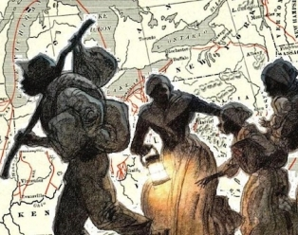
MAPPING THE CHICAGOLAND UNDERGROUND RAILROAD
Team Name :
Team 5 UGRR using QGIS AKA
Historic Horizons
Team Members :
Khaja Moinuddin
Melissa Cornfield
Geetha Krishna Pavansai Ravipati
Notes:
Khaja Slide

Slide 2
Introduction
Problem Statement
The problem we are addressing revolves around the lack of accessible and engaging educational resources to uncover and showcase the historical significance of sites along the Little Calumet River related to the Underground Railroad (UGRR). Despite the importance of this history, the public is often unaware of its significance, and existing resources that may not effectively engage the community or convey the story in a dynamic way.
Notes:
Khaja Slide

Slide 3
PROJECT OVERVIEW
Objective :
Develop an interactive digital map to help educate the public and engage the community about the UGRR sites in the Chicago Southland.
Goal :
Uncover and showcase the historical significance of sites along the Little Calumet River related to the Underground Railroad (UGRR).
Notes:
Khaja Slide

Slide 4
Data Preparation
Collection of Primary Source Documentation
Identification of UGRR Sites based on Primary Source Documentation
Sites along the Little Calumet River that have connections to the Underground Railroad will also be identified
Data organized and Geocoded into a spreadsheet for the Mapping
Notes:
Khaja Slide

Slide 5
Census Data
Census data is a systematic collection of information about a population.
Census data is a vital tool for decision-making and planning at various levels.
We created spreadsheets of the census data from the year 1830, 1840, 1850 & 1860.
Created shapefiles to be added as layers to the Map.
Notes:
Khaja Slide

Slide 6
QGIS SOFTWARE
Free and Open-Source
Cost Effective
High-Quality Polished Map Comprehensive Data Coverage User-Friendly
Customizable and integrates well with open-source data and basemaps
Notes:
Khaja Slide

Slide 7
Advance Pop-up Functions in QGIS
Custom use of HTML and CSS
You can use HTML to format popups, allowing for rich text, images, and videos.
CSS can be added to style the popups for better visual presentation.
Conditional Formatting
Implement conditional statements to change the content based on attribute values.
Custom Actions
Define actions that can be executed from popups, such as opening a URL or launching a script.
Dynamic Content Updates
Use real-time data or calculations within popups, enabling them to reflect changes in the underlying data
Notes:
Khaja Slide

Slide 8
Tech Stack Used
Excel
QGIS:
Used to Create GIS Map
HTML
Used to build in Map Functionality needed for uses to investigate Map
GitHub
Used to Publish Map to the Web for Public Consumption
Python
Used To analyze Population Growth by Race
MSFT Word
Used To Present the Project Information to Stakeholders
Used To Collect and Store Data on the UnderGround Railroad sites and the Census Data
Used To document how the team after us can update the map with additional Data points
Powerpoint
Notes:
Melissa Slide

Slide 9
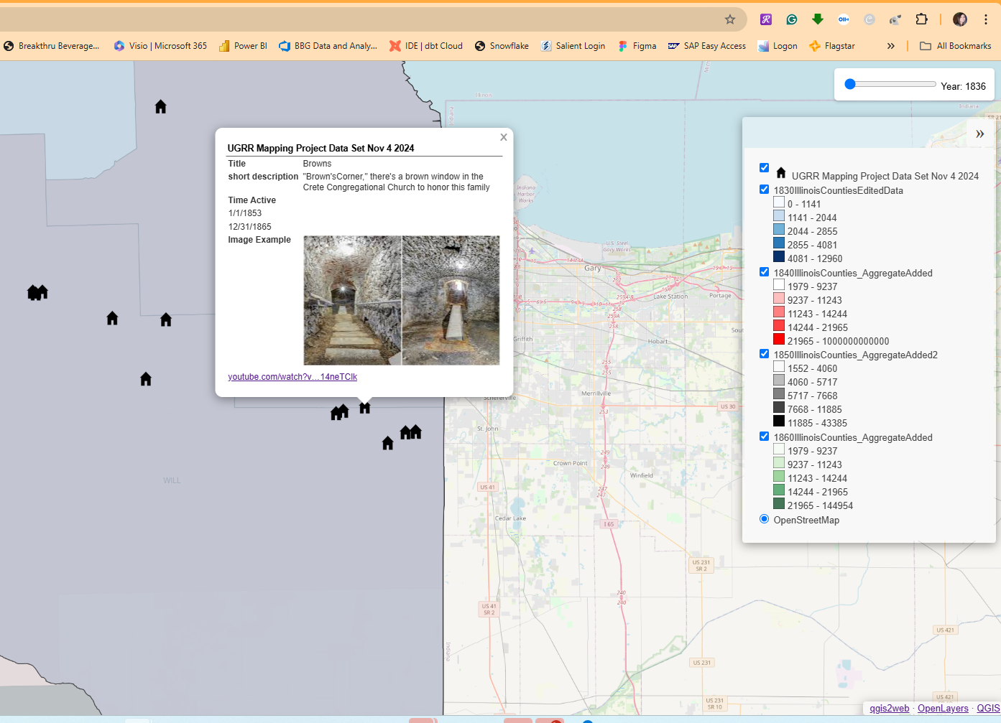

Map Demo
Link To Map
Map - https://melissacornfield.github.io/UnderGroundRailRoadIL/
Notes:
Melissa Slide

Slide 10
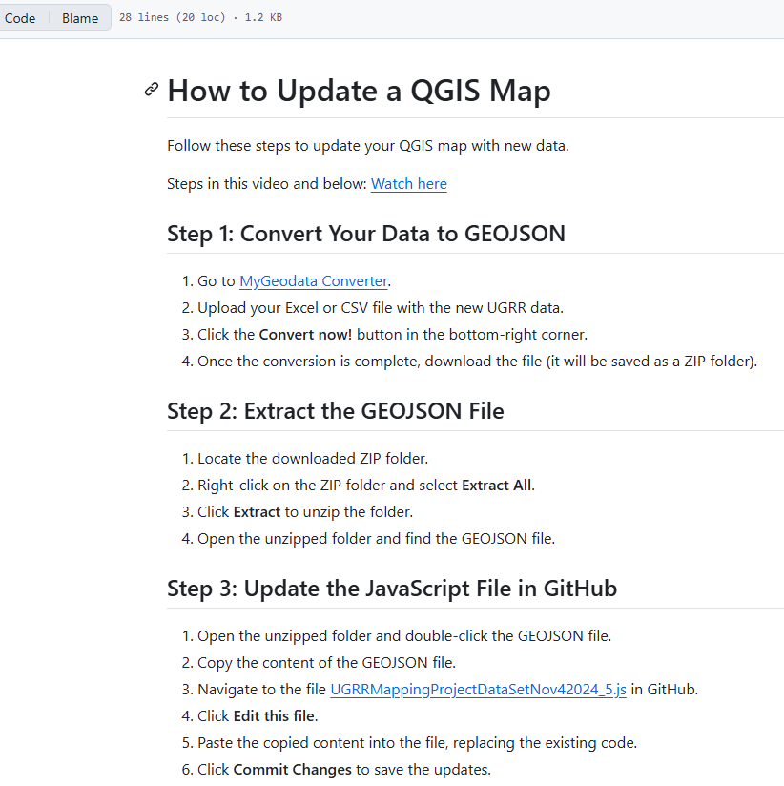

Demo of Instructions
Links for Reference
- Github - https://github.com/melissacornfield/UnderGroundRailRoadIL/blob/main/README.md
- Youtube 1 - https://www.youtube.com/watch?v=zlBsiuhYVps&t=218s
- Youtube 2 - https://www.youtube.com/watch?v=Zb_PTz_9ktw&feature=youtu.be
Notes:
Melissa Slide

Slide 11
Population Growth Analysis for Cook, Will & Du Page Counties
This analysis examines population growth from 1840 to 1860, focusing on White and Black populations in Cook, Will, and Du Page Counties.
Population Growth (1840-1860):
Cook County:
White population: Increased from 10,201 in 1840 to 74,162 in 1860.
Black population: Grew from 55 in 1840 to 1,007 in 1860.
Represents the highest growth rate among the counties.
Will County:
White population: Increased from 10,167 in 1840 to 29,321 in 1860.
Black population: Increased marginally from 10 in 1840 to 57 in 1860.
Du Page County:
White population: Grew from 3,535 in 1840 to 14,701 in 1860.
Black population: Remained very small, with no significant change.
Notes:
Geetha Slide

Slide 12
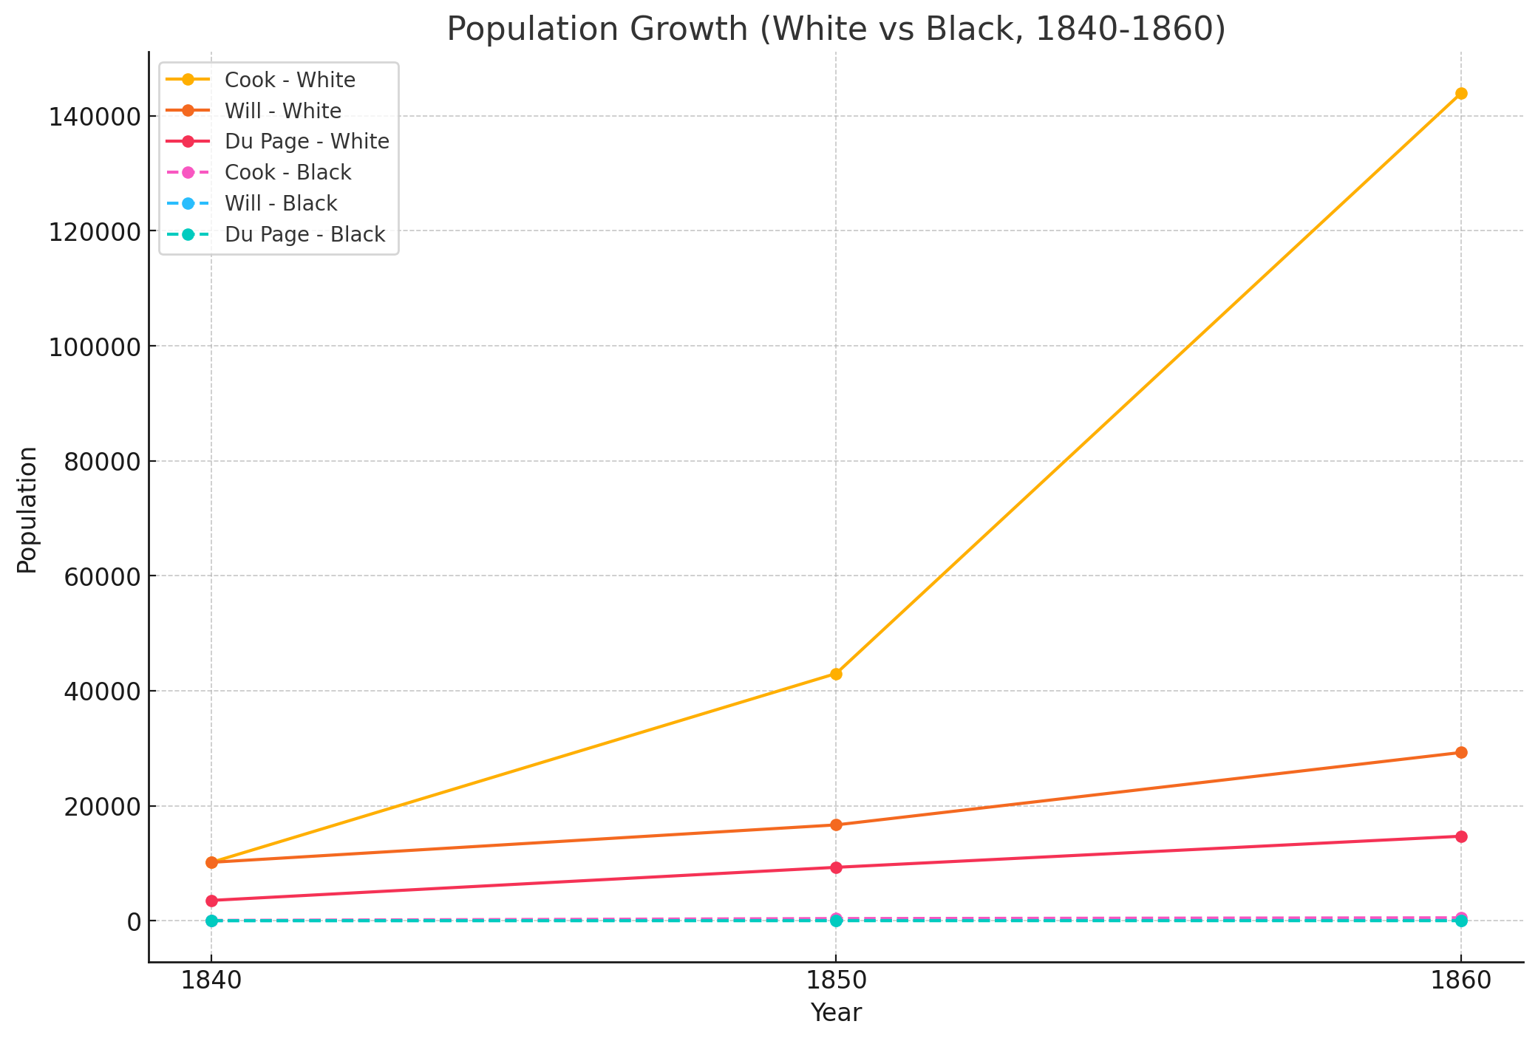
Notes:
Geetha Slide

Slide 13
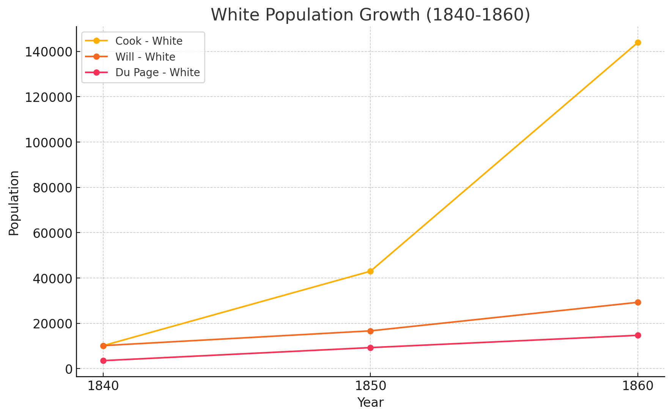
Notes:
Geetha Slide

Slide 14
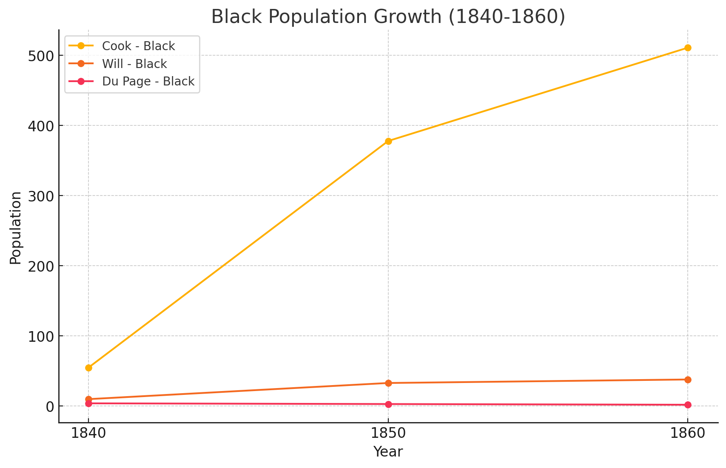
Notes:
Geetha Slide

Slide 15
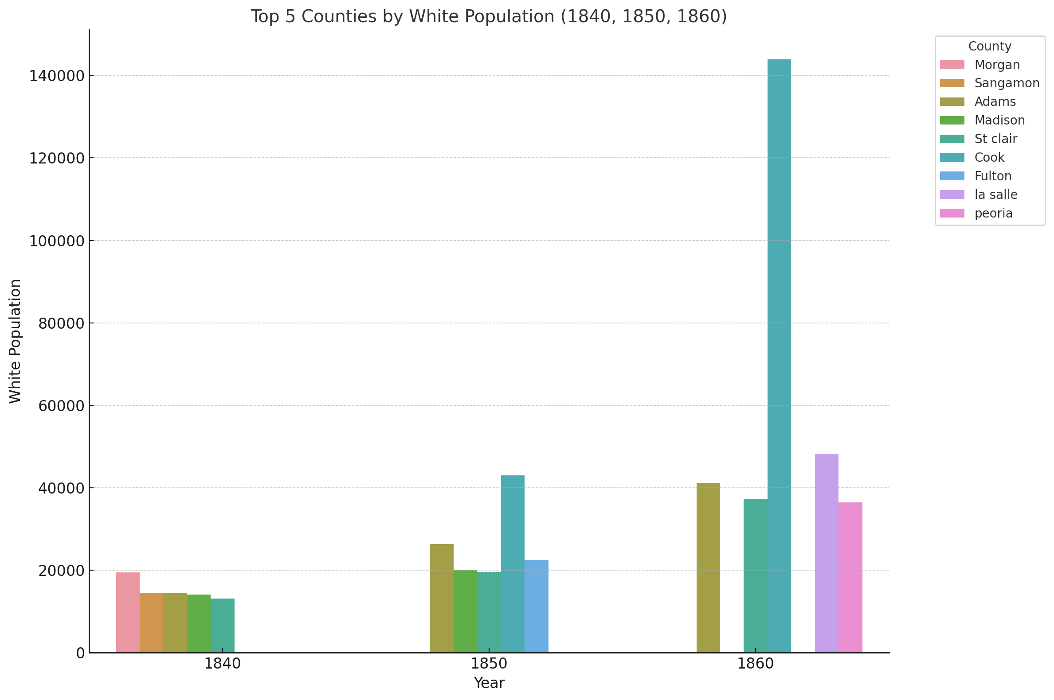
Notes:
Geetha Slide

Slide 16
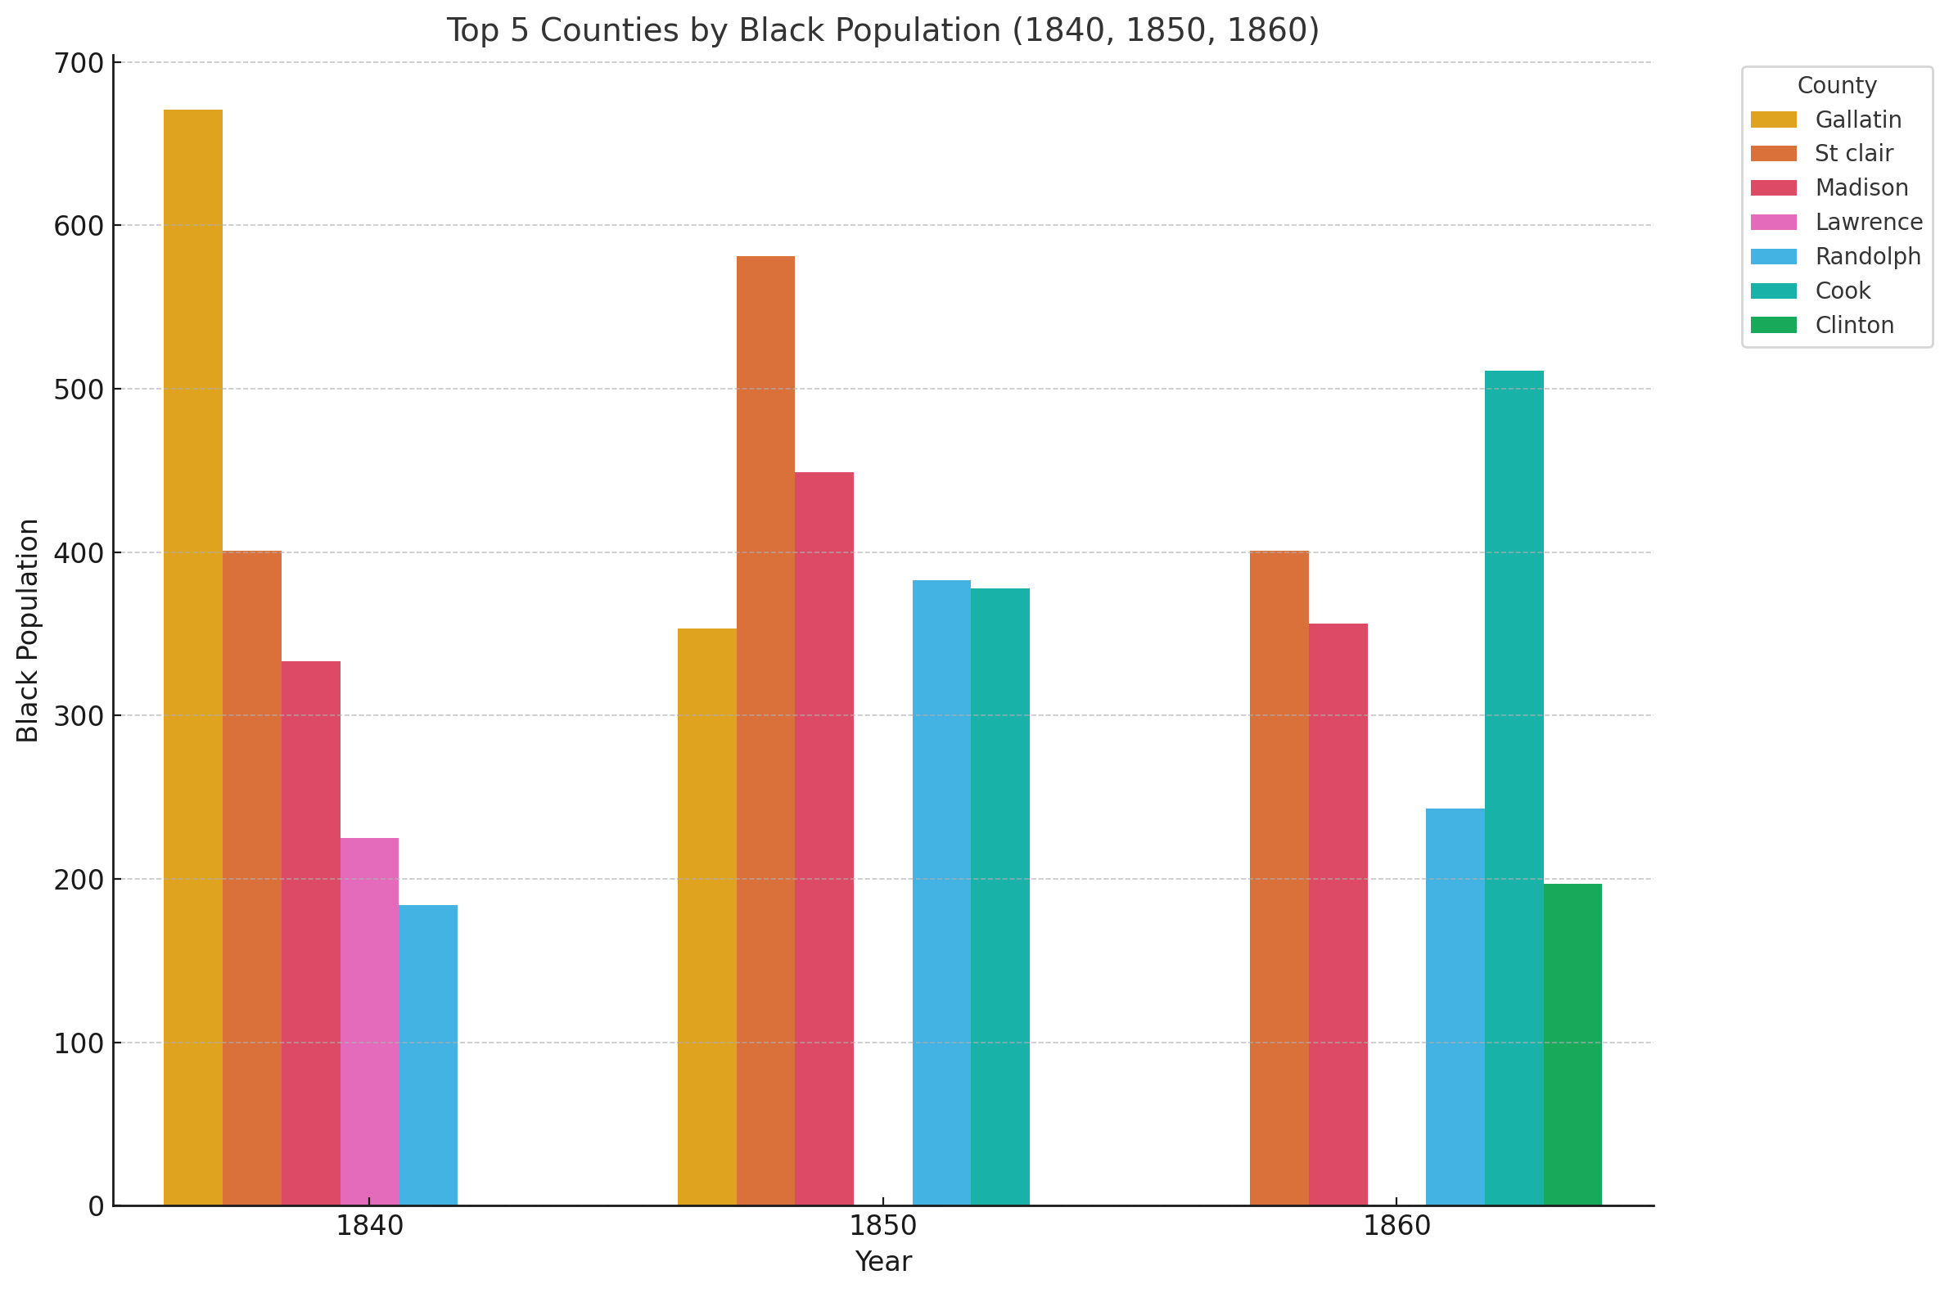
Notes:
Geetha Slide

Slide 17
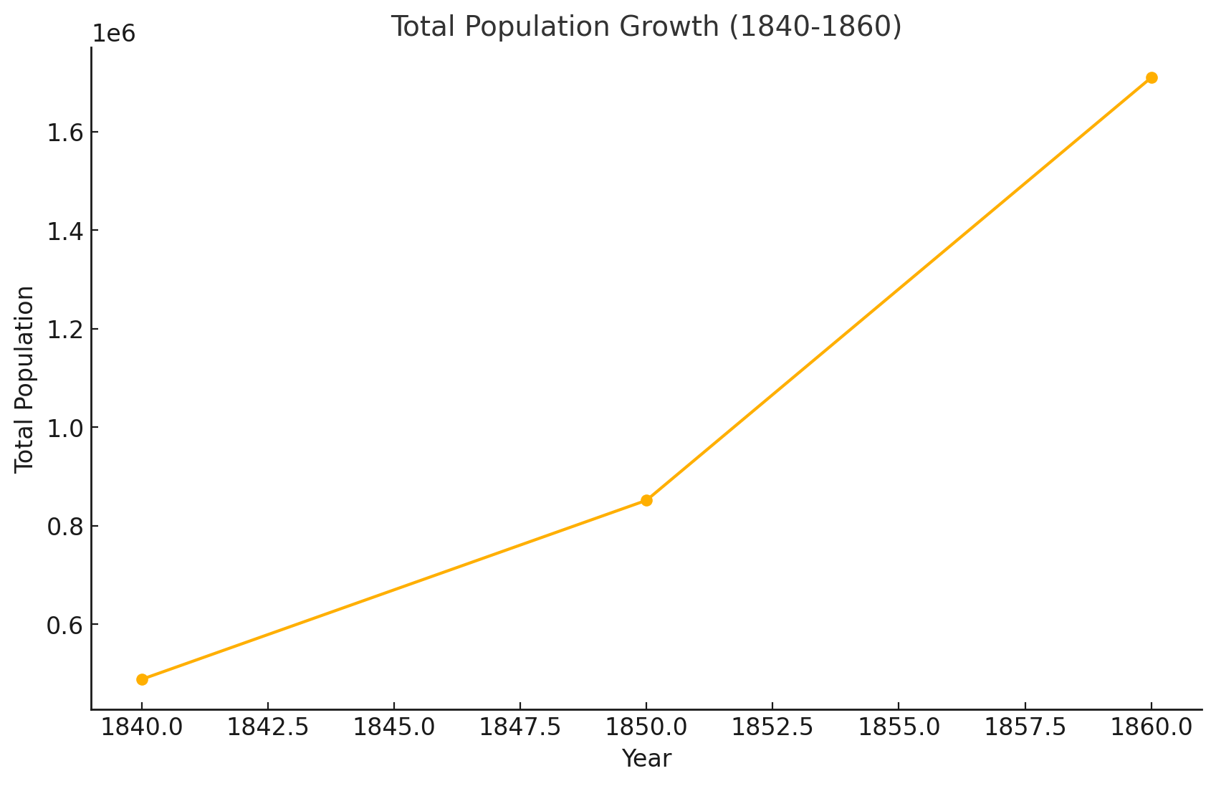
Notes:
Geetha Slide

Slide 18

Conclusion
Hopefully the Information we provided to you today will help:
Preserve and promote local history.
Engage students, teachers, and the general public.
Provide a valuable resource for learning and research.
Notes:
Geetha Slide

